Slide 1
Help Documentation for code
Shengya Guo, CR/AVS3, 29.11.2024

Slide 2
Basic
Conda environment build up: emb_pytorch_requirenmets.txt
Folder of main work: RL_pytorch
Folder of pictures used in thesis: pic for thesis
Folder of plot function for thesis: thesis_plot

Slide 3
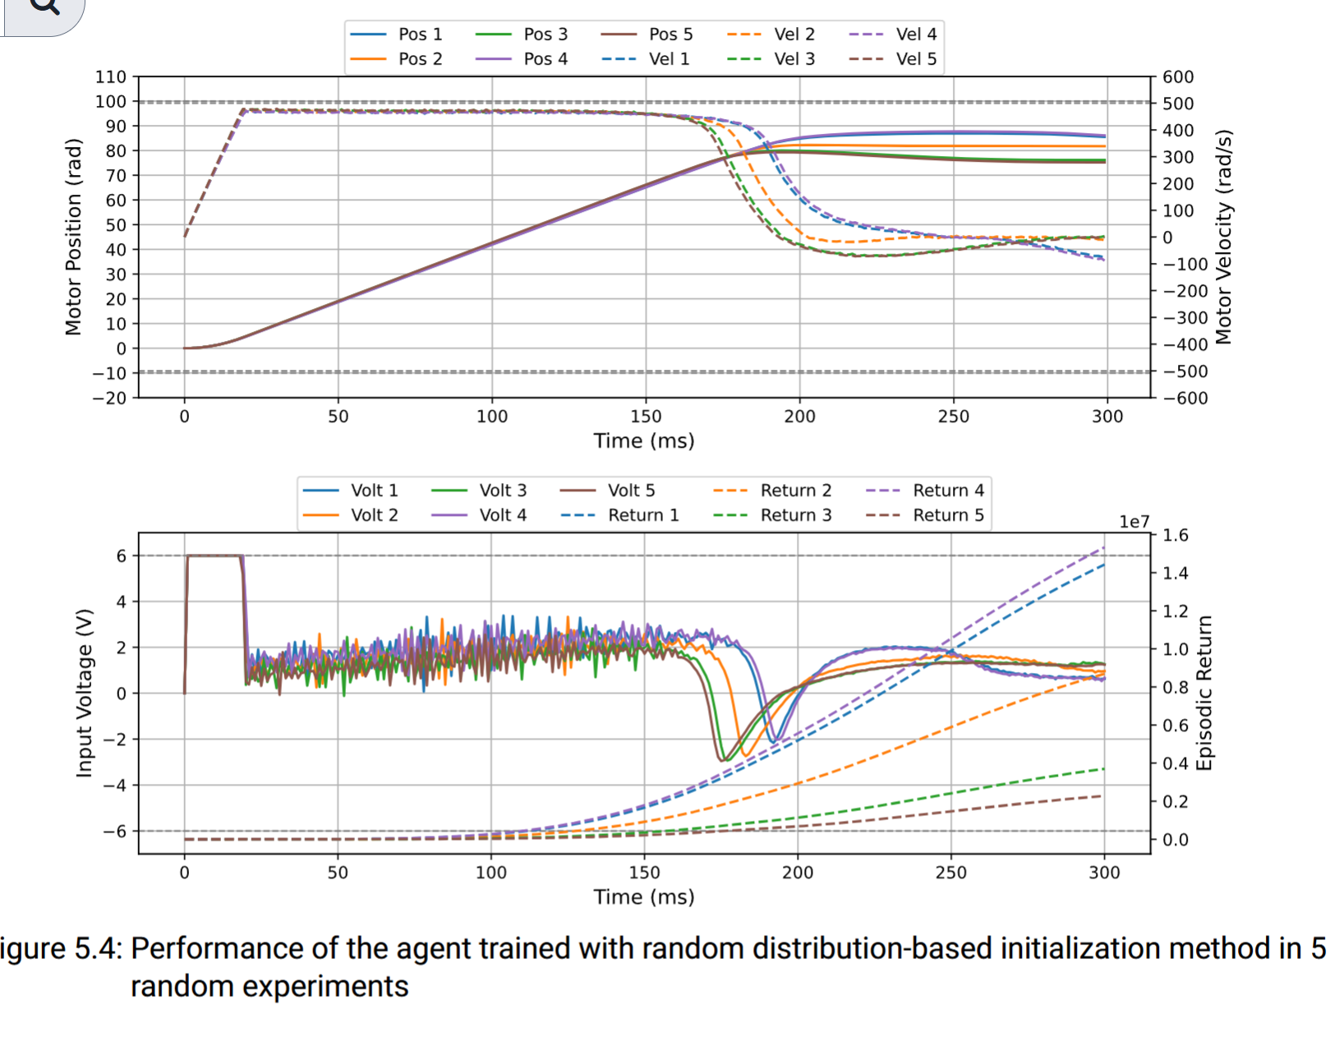
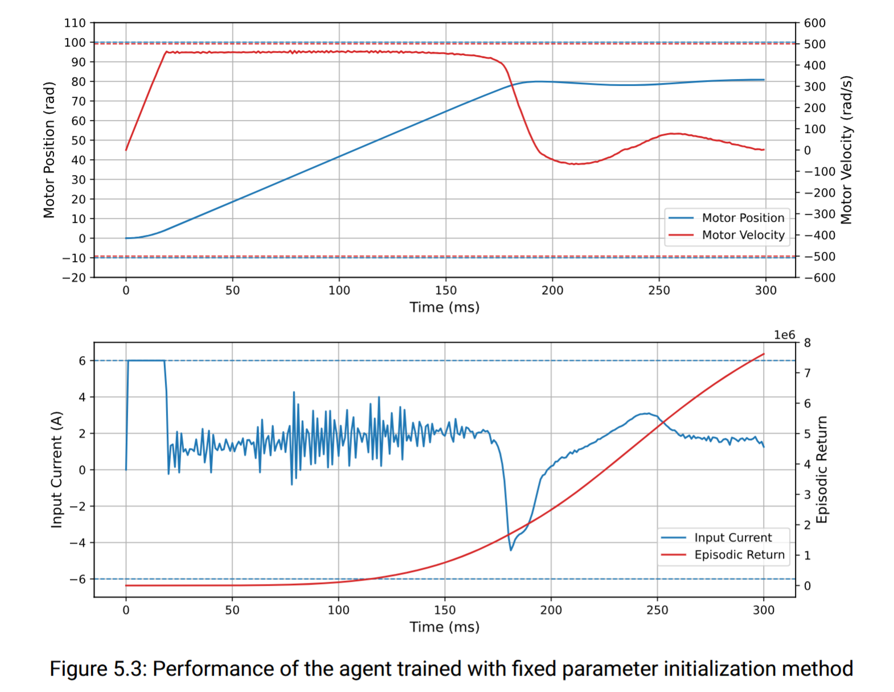
Single Parameter
RL_pytorch
Folder fv_ v1 to fv_v5 and fv_v10
Historic works, not useful
Folder fv_v6
measure value of x1 and x2 in obs
sample fv and fv in obs
no force back to zero point at the end
Best model saved in runs, end with “for_thesis”
For training: python ppo_fv_v6.py
For test: python ppo_fv_v6.py --train-model=False --save-model=False
Folder fv_v7
measure value of x1 and x2 in obs
fixed fv and fv in obs
no force back to zero point at the end
Best model saved in runs, end with “for_thesis”

Slide 4
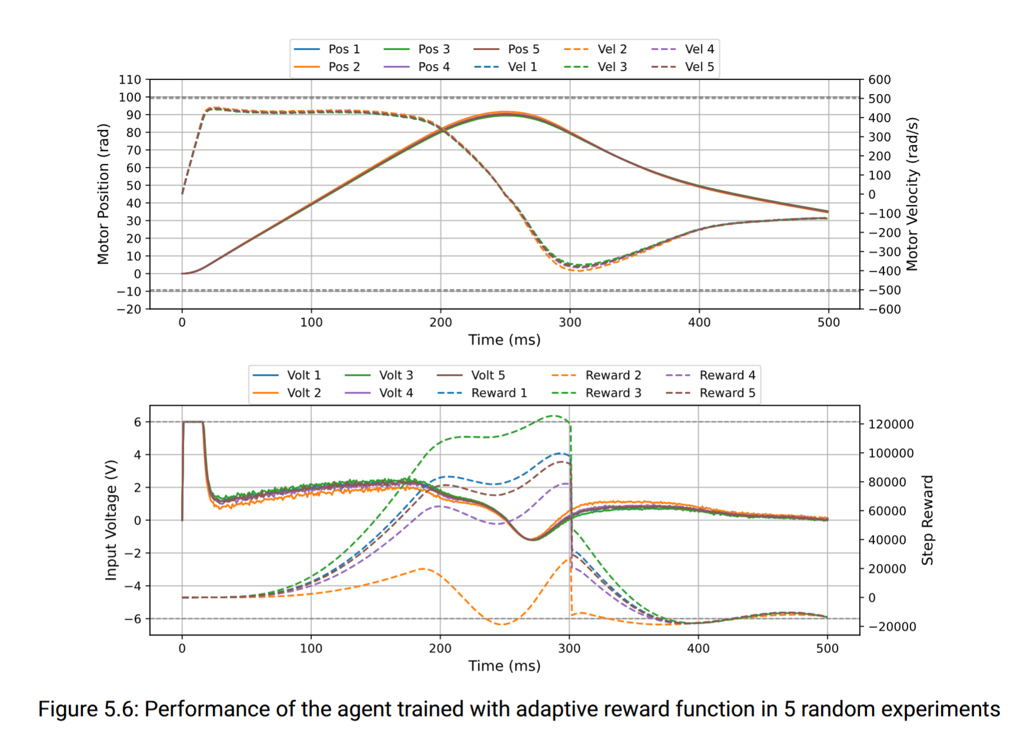
Single Parameter
RL_pytorch
Folder fv_ v9: adaptive reward function
EMB_env_fv_v9:
the right model we want
for actor: mearesed x1 and x2 and k
for critic: real x1 and x2 and k and fv and FIM
sample fv and fv in obs
h(x) = [x1, x2]
force back to zero
Best result: EMB-fv-v9__ppo_fv_v9__1__20241008-10-1-train/PPO_fv_v9.pth

Slide 5
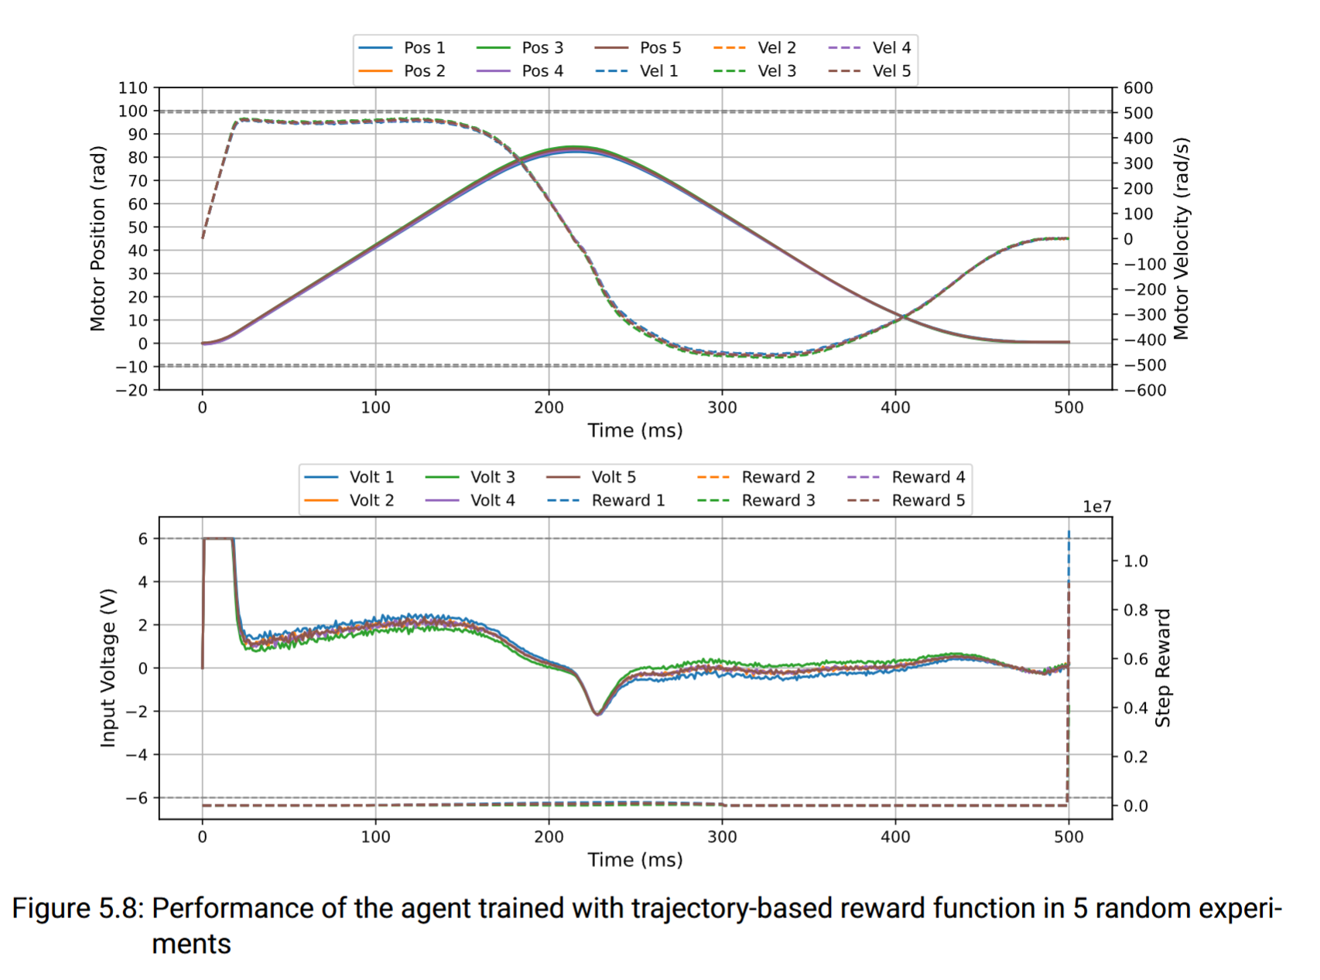
Single Parameter
RL_pytorch
Folder fv_v11: trajectory-based reward function
for actor: measured x1 and x2
for critic: real x1 and x2 and k and fv and FIM
sample fv and fv in obs
h(x) = [x1, x2]
force back to zero with reward function v3: quintic polynomial
x1 x2 reset around 0
Best result: runs/EMB-fv-v11__ppo_fv_v11__4911__20241027-train-good/PPO_fv_v11_244.pth

Slide 6
Multi Parameter
RL_pytorch
Folder fvk1_v1:
for actor: measured x1 and x2
Reward based on logarithm D-optimality with FIM scale
Bad result

Slide 7
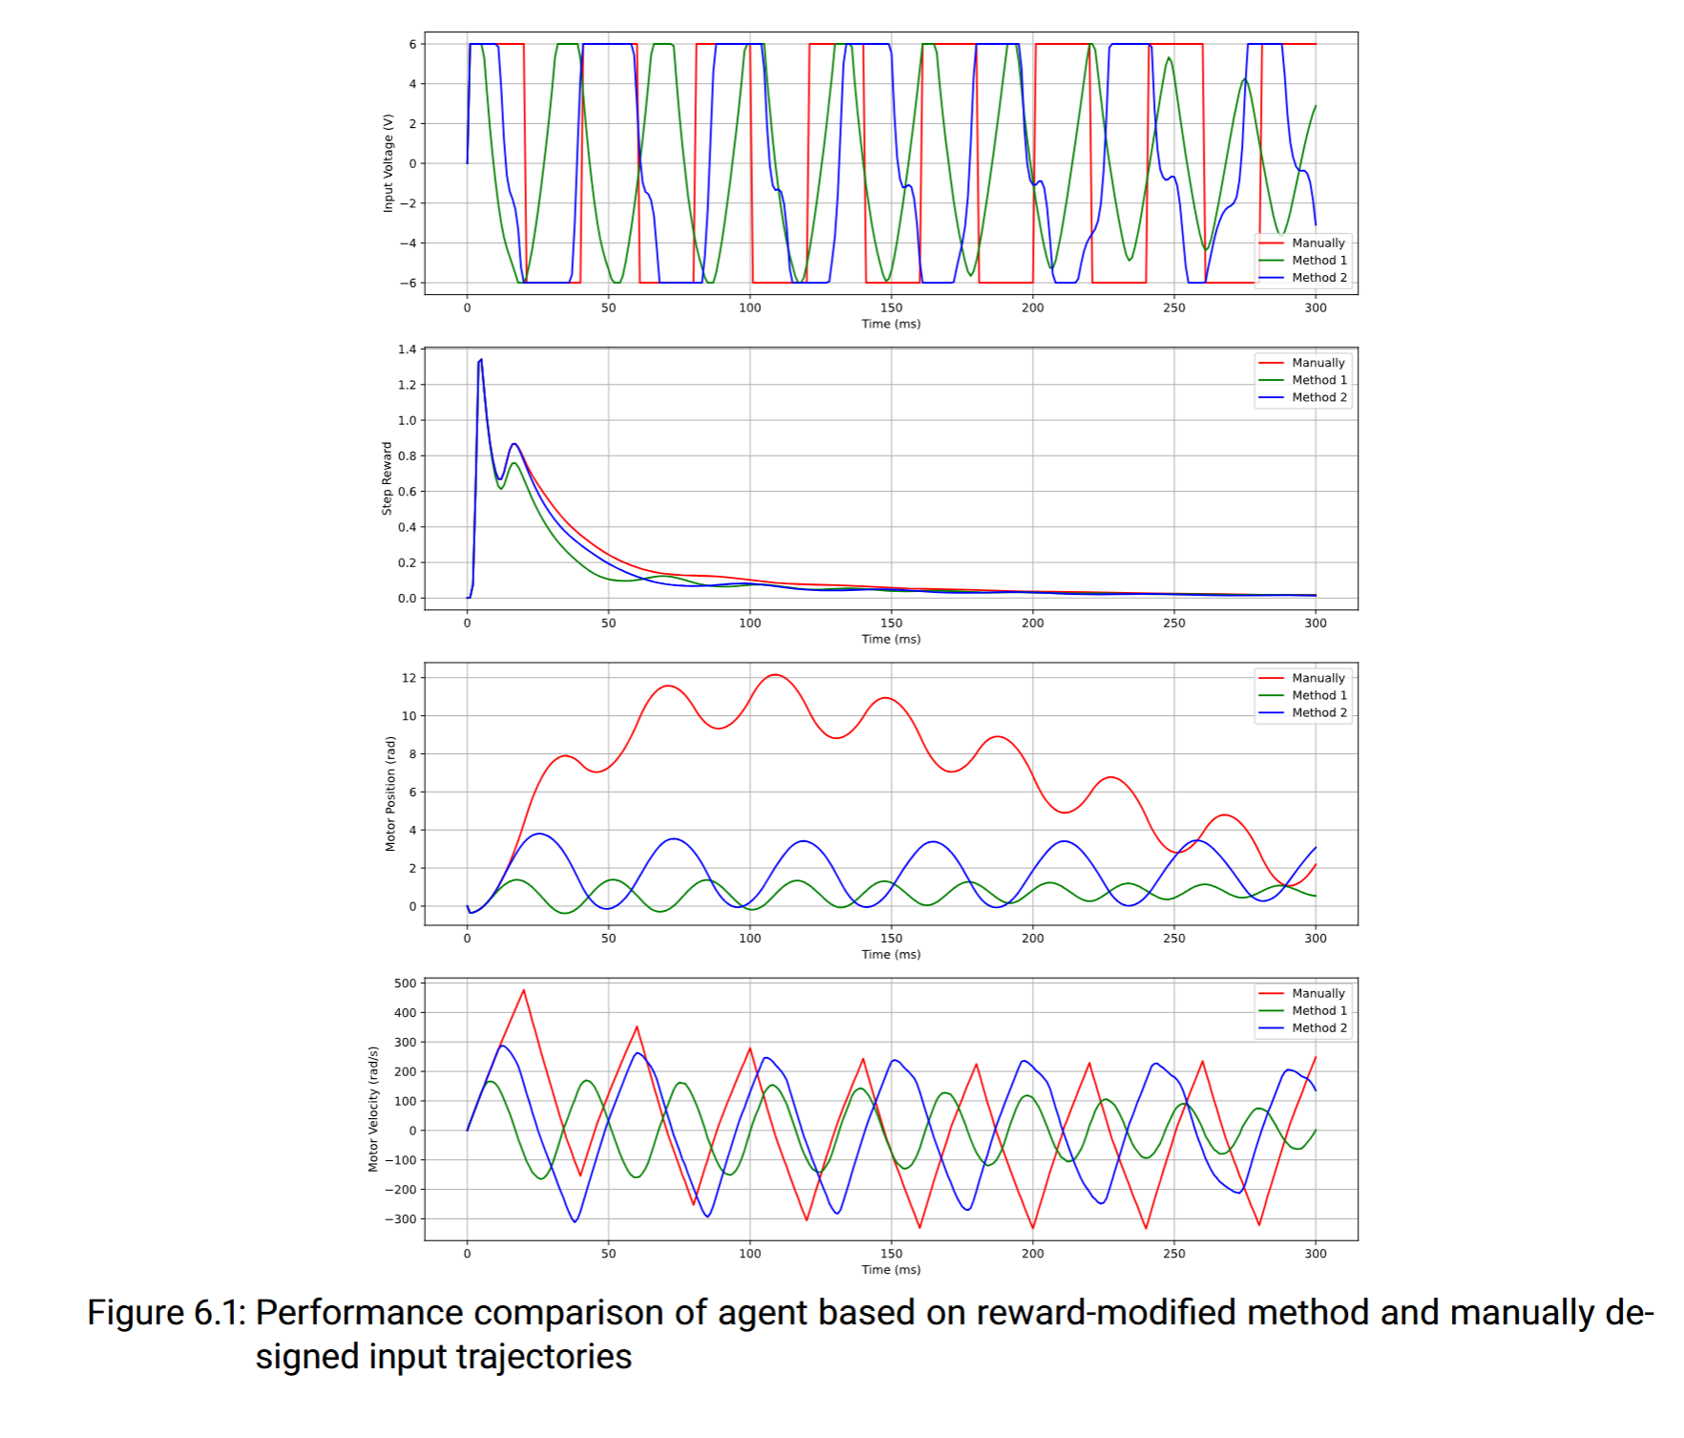
Multi Parameter
RL_pytorch
Folder fvk1_v1: Modification of the step reward function
for actor: measured x1 and x2
Reward based on logarithm of D-optimality with FIM scale
Result not good
Reward function
Method 1 in Thesis: runs/EMB-fvk1-v1__ppo_fvk1_v1__1__20241020-300ms/PPO_fvk1_v1_244.pth
Method 2 in Thesis: runs/EMB-fvk1-v1__ppo_fvk1_v1__1__20241022-v2-train/PPO_fvk1_v1_244.pth

Slide 8
Multi Parameter
RL_pytorch
Folder fvk1_v3:
for actor: measured x1 and x2
Reward based on D-optimality, no log, no scale
Result not good

Slide 9
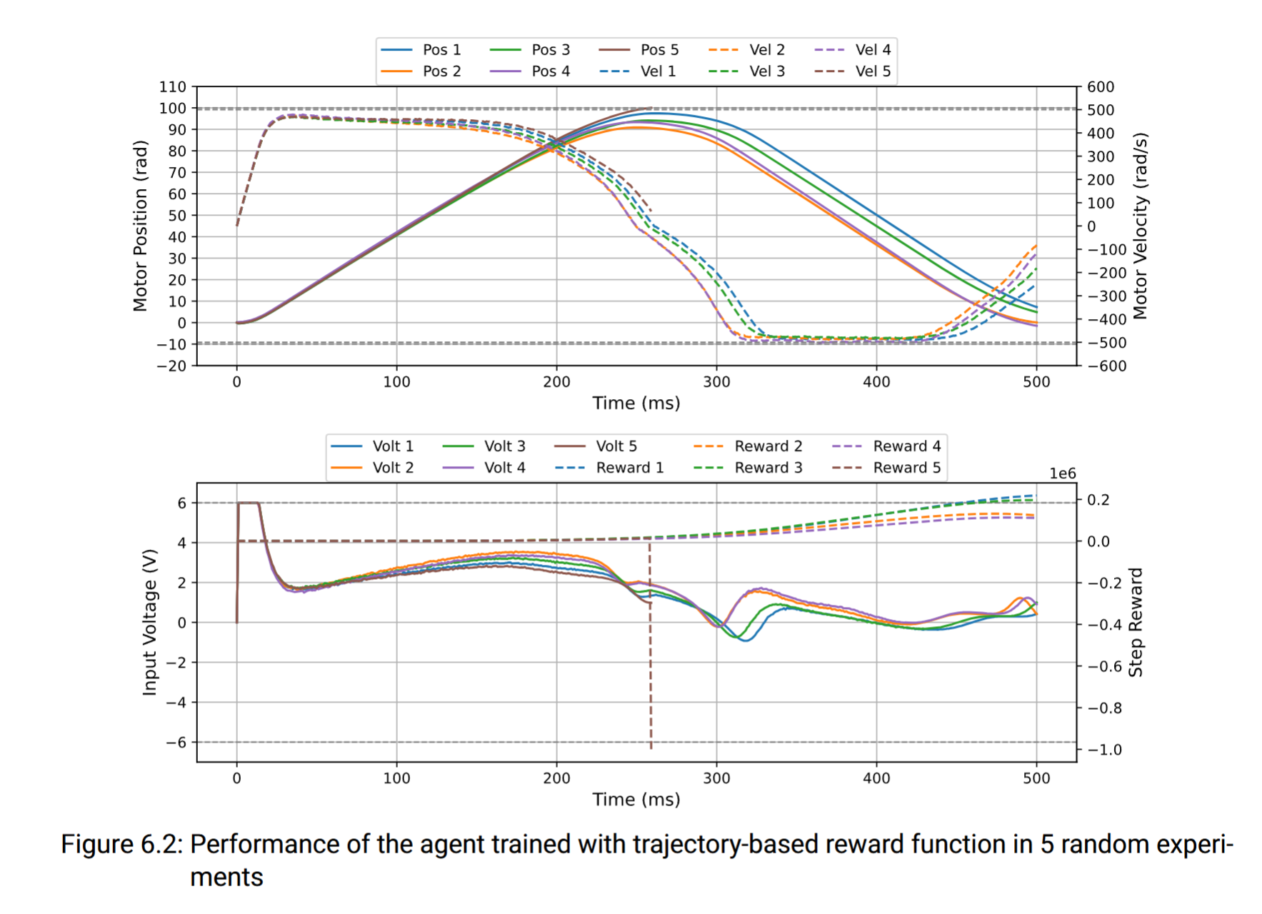
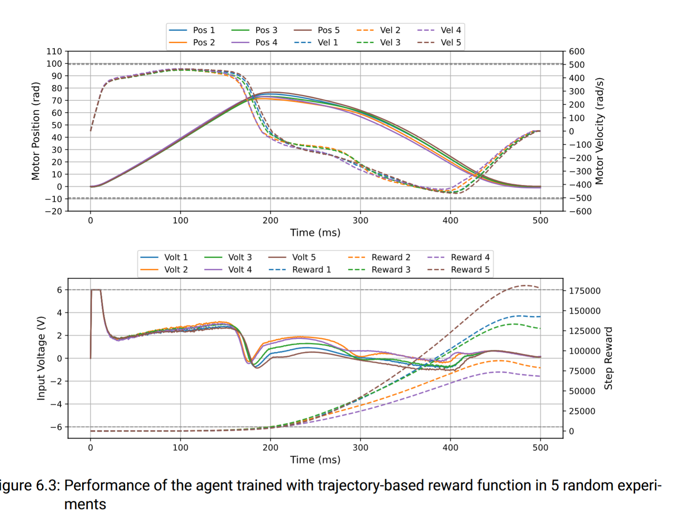
Multi Parameter
RL_pytorch
Folder fvk1_v4:
Reward based on E-optimality
trajectory-based reward function design with E-optimality
runs/EMB-fvk1-v4__ppo_fvk1_v4__1492__20241101-5e-4-cp0.25-5m-backreward-dangerous85/ppo_fvk1_v4_610.pth
integration of the trajectory-based and adaptive reward function design
runs/EMB-fvk1-v4__ppo_fvk1_v4__1492__20241111-002131/ppo_fvk1_v4_610.pth

Slide 10
Not up to date, don’t use it firstly
Historic works
Folder of works with TensorFlow: RL
Folder of autograd with the caculation of FIM: Sensitivities function research

